Slide 1
Implementing Stateless Clients in Ethereum
Souvik Banerjee
Advisor: Vijay Chidambaram Second Reader: Chris Rossbach
Third Reader: Alan K. Cline
Notes:
10 seconds

Slide 2
Outline
Motivation
Background
Stateless Clients
Implementation
Results
Conclusions and Future Work
Notes:
30 seconds

Slide 3
Blockchain
A decentralized data sharing technology
Records transactions in an immutable ledger
Used in many applications
Notes:
45 seconds

Slide 4
Ethereum
A platform for blockchain applications
Most popular application: cryptocurrency (1 ETH ≈ 166 USD)
Blockchain applications are written using smart contracts
Notes:
45 seconds

Slide 5

Smart Contracts
Computer programs that run in a secure environment
Written in Solidity
Turing-complete programming language
Applications
Notes:
2 minutes

Slide 6
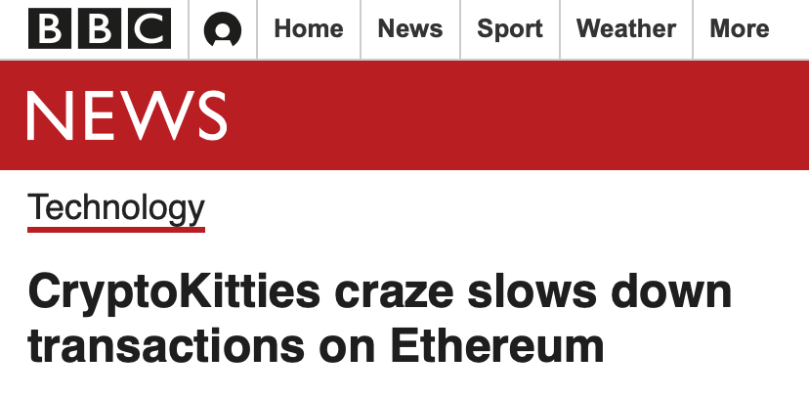
Ethereum Scalability
Ethereum can only process ~15 transactions/second
Visa can process 24000 transactions/second
Smart contracts also contribute to slow transaction throughput
Notes:
1 minute

Slide 7
Ethereum Scalability: I/O
Notes:
TODO: replace graph

Slide 8
Ethereum Scalability
Reducing I/O may improve transaction throughput
Better scalability
Stateless Clients is one proposed solution

Slide 9
Ethereum Internals: Outline
Transactions
Blocks
RLP Encoding
Merkle-Patricia Trie
State Transition Function
Proof-Of-Work (PoW) Consensus

Slide 10
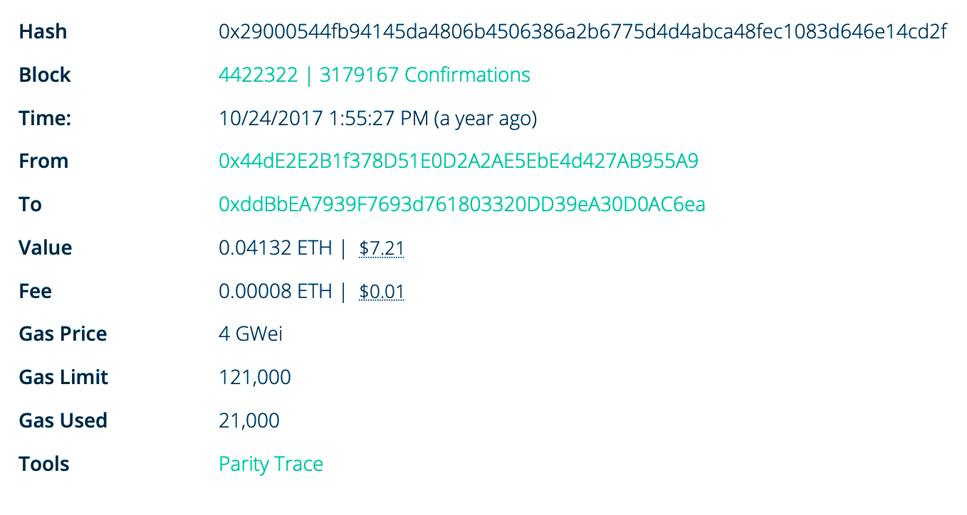
Transactions
How the outside world communicates with Ethereum
Transactions have senders and receivers

Slide 11
Blocks
Blocks contain many transactions and a block header
Hashed with SHA-3

Slide 12
RLP Encoding
Encoding scheme for serializing data structures
Similar to JSON, but only supports lists and binary data

Slide 13
Merkle-Patricia Trie
How Ethereum stores account balances and other metadata
Ethereum world state
Builds upon both Merkle trees and radix tries
Nodes are serialized with RLP and link to child nodes by their SHA-3 hash
Hashes for child nodes are stored inside the parent node
Hash of a node depends on hashes of its children, which are dependent on the hashes of grandchildren, etc.
Hash of the root node uniquely identifies the entire trie

Slide 14
Merkle-Patricia Trie

Slide 15
Merkle-Patricia Trie

Slide 16
Merkle-Patricia Trie
Can be used to verify values in the trie (Merkle proof)
Merkle Proof of a value v
Set of nodes along the path to the value v in the trie
Verifying a Merkle Proof
Given the root hash of the trie and a Merkle Proof of v, v can be verified

Slide 17
Merkle-Patricia Trie

Slide 18
Merkle-Patricia Trie
Merkle-Patricia trie nodes are typically stored in a key-value store
LevelDB, RocksDB
“Pointer-chasing”

Slide 19
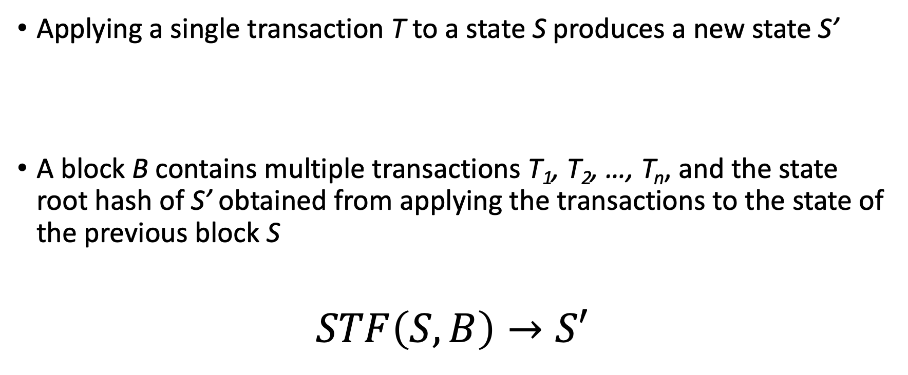
Ethereum State Transition Function
Applying a single transaction T to a state S produces a new state S’
A block B contains multiple transactions T₁, T₂, …, T_{n}, and the state root hash of S’ obtained from applying the transactions to the state of the previous block S
$$STF\left(S,B\right)→S′$$

Slide 20
Proof-Of-Work Consensus
Ethereum is a distributed system
Every full node stores the blockchain and participates in verifying blocks
Miners create blocks from transactions they receive from users and send them to full nodes
PoW prevents abuse by requiring nodes to perform expensive tasks and provide proof that the task has been completed

Slide 21
Proof-Of-Work Consensus
Work: Make the SHA-3 hash of the block match some condition
A field in the block header called the nonce is modified until the hash of the block matches the PoW condition
Proof: The SHA-3 hash of the block matches the condition
Verifying proof is not computationally expensive
Ethereum mining uses the Ethash algorithm
Mining gets progressively more difficult over time
DAG is regenerated every 30000 blocks (epoch transition)
Miners get rewarded

Slide 22
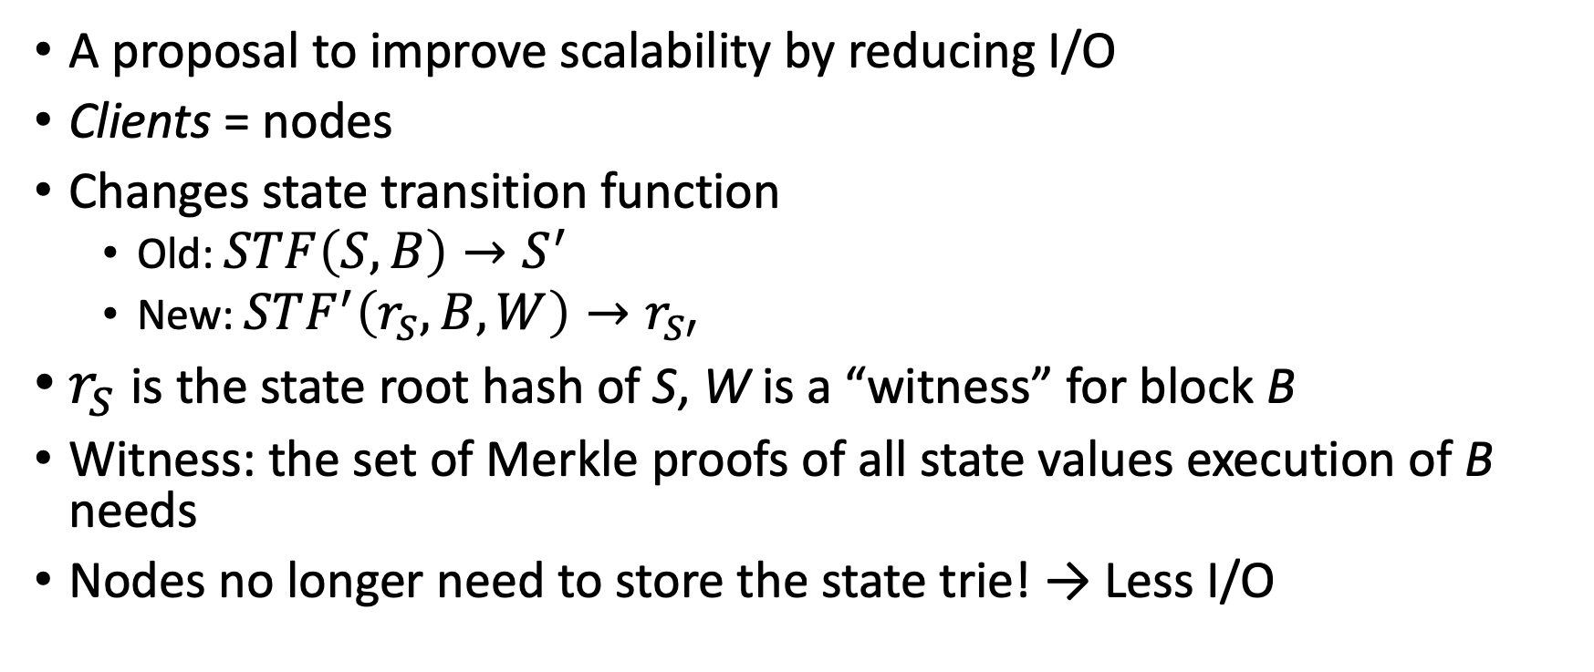
Stateless Clients
A proposal to improve scalability by reducing I/O
Clients = nodes
Changes state transition function
Old: $STF\left(S,B\right)→S^{′}$
New: $STF^{′}\left(r_{S},B,W\right)→r_{S′}$
$r_{S}$ is the state root hash of S, W is a “witness” for block B
Witness: the set of Merkle proofs of all state values execution of B needs
Nodes no longer need to store the state trie! → Less I/O

Slide 23
Stateless Clients
Witnesses are generated when blocks are created
Miner keeps track of what state values are needed to execute the block
Witnesses are sent along with blocks to other Ethereum nodes
Instead of using state trie, verifier nodes use the witness

Slide 24
Stateless Clients: Example
State root, hash: 0x0986…876c
Account
0x1354…f78b
100 ETH
Account
0x298a…e3b1
1 ETH
Account
0x737b…fc91
13 ETH
Account
0xa98b…3645
13 ETH

Slide 25
Stateless Clients: Example
State root, hash: 0x0986…876c
Account
0x1354…f78b
100 ETH
Account
0x298a…e3b1
1 ETH
Account
0x737b…fc91
13 ETH
Account
0xa98b…3645
13 ETH

Slide 26
Stateless Clients: Example
State root, hash: 0xa34c…2f55
Account
0x1354…f78b
90 ETH
Account
0x298a…e3b1
11 ETH
Account
0x737b…fc91
18 ETH
Account
0xa98b…3645
13 ETH

Slide 27
Stateless Clients: Example
Merkle-Patricia trie nodes are added to the block
Verifier receives this block
Expected state root hash is specified in block header

Slide 28
Stateless Clients: Example
State root, hash: 0x0986…876c
Reconstruct Merkle-Patricia trie from nodes in witness
Account
0x1354…f78b
100 ETH
Account
0x298a…e3b1
1 ETH
Account
0x737b…fc91
13 ETH

Slide 29
Stateless Clients: Example
State root, hash: 0xa34c…2f55
State root hash matches!
Account
0x1354…f78b
90 ETH
Account
0x298a…e3b1
11 ETH
Account
0x737b…fc91
18 ETH

Slide 30
Implementation
I implemented Stateless Clients in Parity
Parity: Ethereum Client written in Rust
6000 Lines of code

Slide 31
Results
Witness Size
Directory Size
I/O Operations
Throughput
Setup
Intel Xeon E3-1220 v5, 3.0 GHz
16 GB RAM
Intel 750 Series NVMe SSD

Slide 32
Witness Size
For every block, generate the associated witness
Used 7.3 million blocks from the real Ethereum blockchain

Slide 33
Witness Size
Average Witness Size: 723 KB
Largest Witness Size: 49.2 MB at block 2306350
Large spike is from a DDoS attack in Ethereum
Created lots of empty accounts

Slide 34
Witness Size vs. Block Size
Witnesses are much larger than the blocks!

Slide 35
Witness Size vs. Block Size
Witnesses are much larger than the blocks!
40x to 100x size increase

Slide 36
Directory Size
Parity stores all of its data in a directory
Specify with the --base-path argument
Terminology
Stateful Client: Parity with the Stateless Clients implementation, but still has a Merkle-Patricia state trie
Stateless Client: Parity with the Stateless Clients implementation without the state trie.

Slide 37
Directory Size
Increases much faster than unmodified client
Ran out of space!

Slide 38
Directory Size
Projected directory size exceeds 5 TB

Slide 39
I/O Operations
Parity stores data in RocksDB
Measured I/O in unmodified Parity and Parity with Stateless Clients
Reads + writes to/from RocksDB
Imported 7.3 million blocks

Slide 40
I/O Operations
Unmodified Parity: 5000 – 15000 operations required to verify a single block
Almost all operations are from traversing the state trie

Slide 41
I/O Operations in Stateless Clients
Block verification
1 Read operation to check if block has been verified
1 Read operation to check epoch transition
1 Read operation per uncle block (up to 2 uncles)
1 Write operation to store new block data
Total: 3-6 I/O operations!

Slide 42
Verification Throughput
When blocks are imported, they are first verified
Same process as when Ethereum nodes receive blocks over the network
Imported 2.3 million blocks into unmodified Parity and Parity with Stateless Clients

Slide 43
I/O Operations
Stateless Clients is only around 10% faster than unmodified Parity
Reasons
Still storing large amount of data
Profiling data shows many calls to SHA-3 hash function
Need to calculate SHA-3 of nodes in witness

Slide 44
Conclusions
Stateless Clients works by bundling witnesses into blocks, allowing verifiers to read state values from the witness
Reduces I/O operations
Witness size is extremely large
40-100x larger
Modest throughput gains

Slide 45
Future Work
Ethereum 2.0 Sharding
Builds on top of stateless clients
Shard execution and storage over multiple groups of Ethereum nodes
Nodes are frequently reshuffled
Hyperledger Fabric
Execute-order-validate architecture
Witness caching and revision
Reduce witness size

